Slide 1

Java ObjectInputStream Class
An ObjectInputStream deserializes primitive data and objects previously written using an ObjectOutputStream. Only objects that support the java.io.Serializable or java.io.Externalizable interface can be read from streams.
The Java ObjectInputStream class enables you to read Java objects from an InputStream instead of just raw bytes. You wrap an InputStream in a ObjectInputStream and then you can read objects from it. Of course the bytes read must represent a valid, serialized Java object. Otherwise reading objects will fail.
Normally we will use the ObjectInputStream to read objects written (serialized) by a Java ObjectOutputStream .
PrintStream
InputStream(i.e FileInputStream)
ObjectInputStream
Java Application
Read
Read

Slide 2
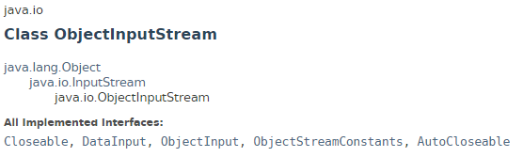
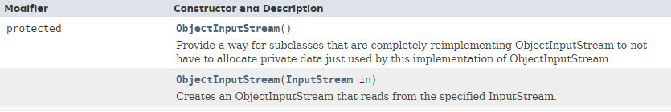
Java ObjectInputStream Class

Slide 3
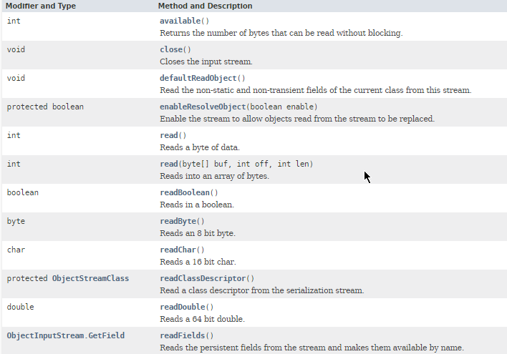
Java ObjectInputStream Class

Slide 4
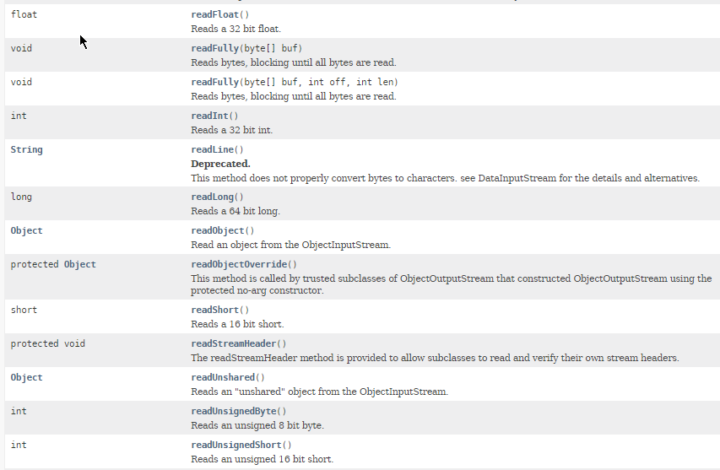
Java ObjectInputStream Class

Slide 5
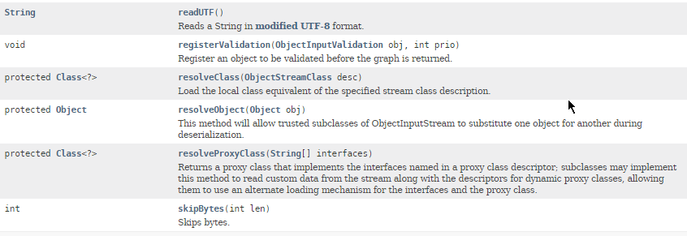
Java ObjectInputStream Class

Slide 6
Java ObjectInputStream Class
https://docs.oracle.com/javase/8/docs/api/index.html?java/io/ObjectInputStream.html

